Slide 1
Data Ethics
Data ain’t magic
Quinn Underriner

Slide 2









How do you create the largest amount of wealth ever geographically centralized in human history?
A: Arbitrage! Or as they say on Wall Street – buy low, sell high
People significantly misprice the value of their own data (not that many are even doing this calculation, or aware of the transaction they are participating in)
Q: Why did Amazon get its start as a book seller?
Largest 5 companies in 2007
Largest 5 companies in 2017

Slide 3
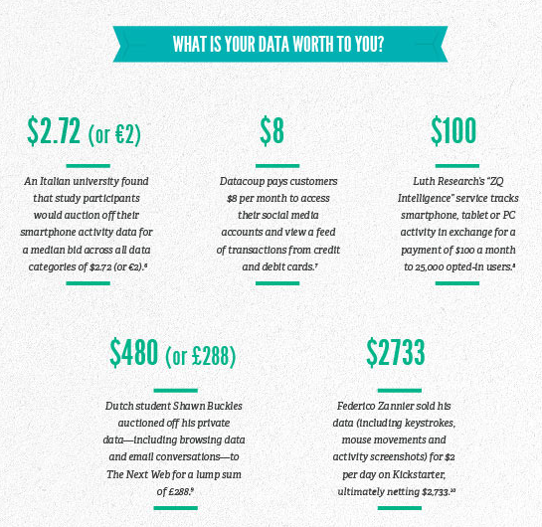

So what is your data worth?
In Caesar’s (the casino) chapter 11 bankruptcy filing some creditors valued their “Total Rewards” customer loyalty program data at $1 billion, making it their largest asset (ahead of physical asset holdings!)
Why did Microsoft buy Linkedin for $26.2 billion? – Consumer data! While its hard to breakdown specific costs (for reference, their revenue in 2015 was only $2.9 billion).
Simple math shows us $260 per monthly active user
http://sloanreview.mit.edu/article/whats-your-data-worth/

Slide 4
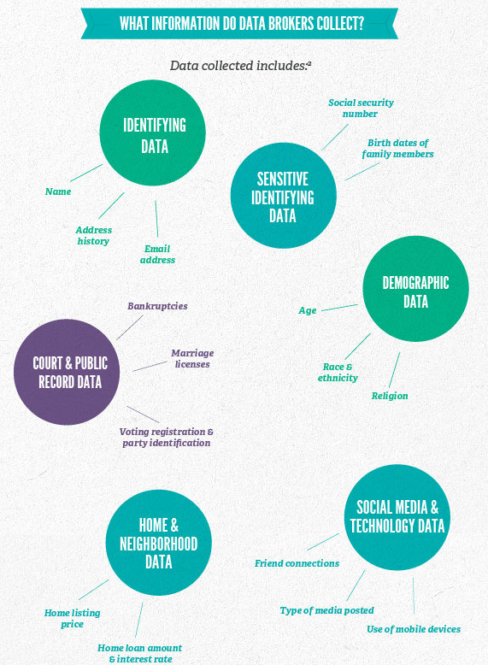
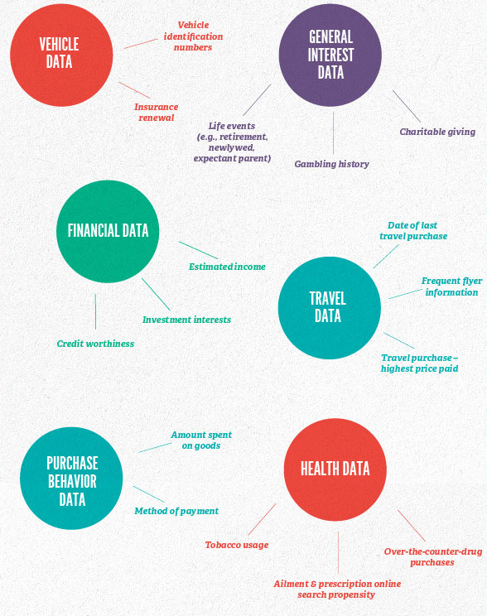
What can data brokers figure out about you?

Slide 5
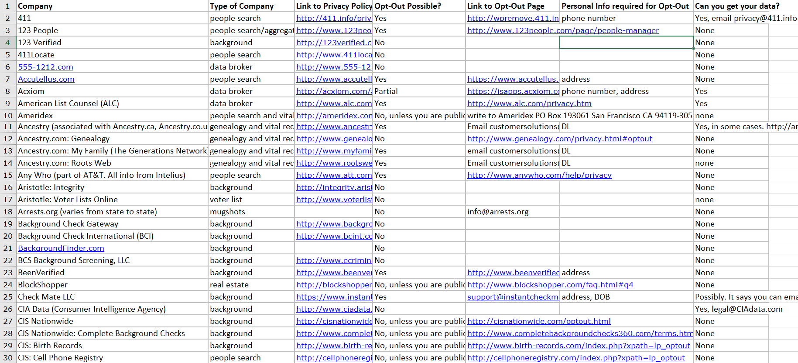
So uh who has my data?
http://juliaangwin.com/privacy-tools-opting-out-from-data-brokers/

Slide 6



A very non-exhaustive list of shifty behavior
Bose wireless headphones noting your listening preferences to be sold to a third-party
Target predicted a teenage girl in Minnesota was pregnant before her parents knew and sent her targeted pregnancy advertisements
Facebook leak shows they create “ghost profiles” of people who are non-users
Vizio TVs tracking what television shows you watch to sell to 3rd parties
My personal favorite privacy violation:
SilverPush, Drawbridge, and Flurry and other data advertising companies who used inaudible noises to link your devices

Slide 7

Who even reads the privacy polices?
Unroll.me CEO Jojo Hedaya said that it was “heartbreaking to see that some of our users were upset to learn about how we monetize our free service.”
A study from Carnegie Mellon estimates that it would cost the U.S. economy $781 billion if people actually read all the privacy polices they came across in a year (and this was in 2008!)

Slide 8
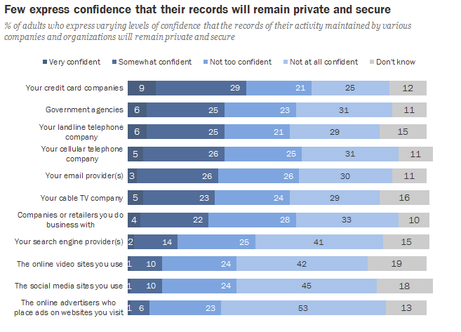
Do American’s care about privacy?
Fully 91% of adults agree or strongly agree that consumers have lost control of how personal information is collected and used by companies
Some 74% say it is “very important” to them that they be in control of who can get information about them, and 65% say it is “very important” to them to control what information is collected about them.
http://www.pewresearch.org/fact-tank/2016/09/21/the-state-of-privacy-in-america/

Slide 9
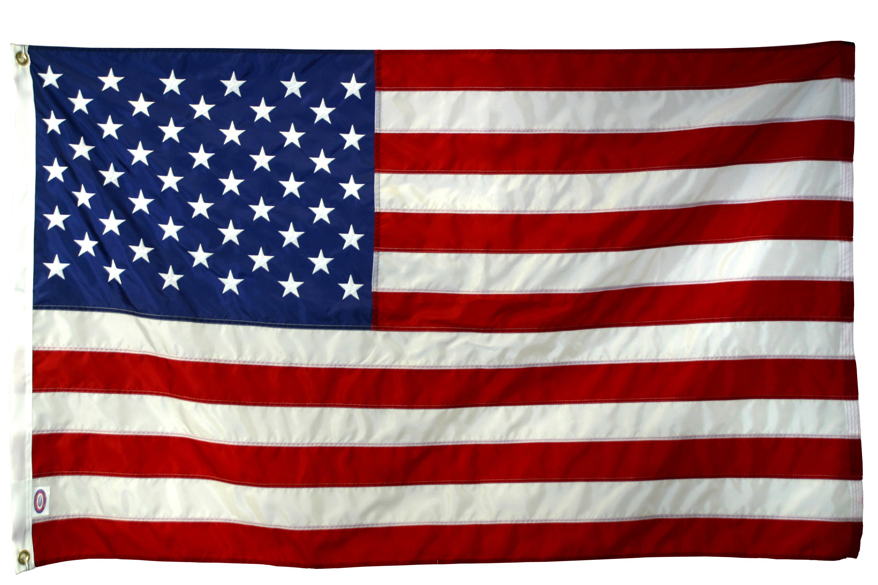
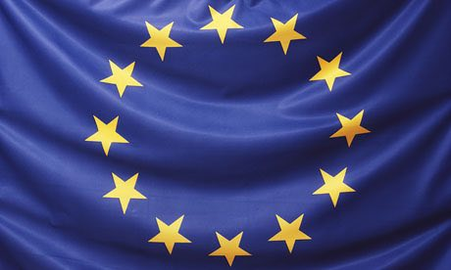
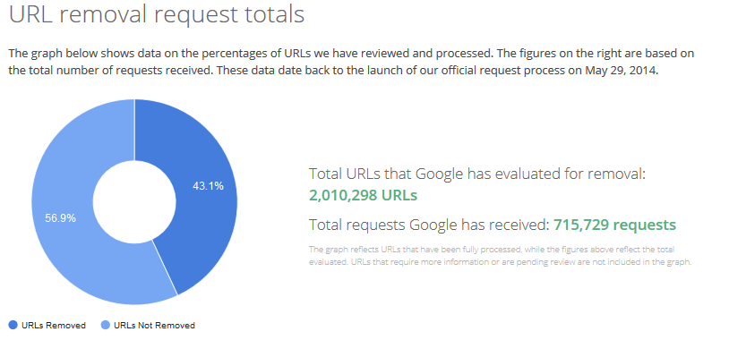
U.S. vs. EU
Privacy considered a fundamental human right in EU (helped by a historical fear of fascism) which allows, for example, for the “Right to be Forgotten”
Strong Centralized Privacy Regulation
Opt–in consent
Generally “pro-business”
Regulations are a patchwork industry and/or state specific laws (e.g., HIPPA for Healthcare, COPPA for children)
Opt–out consent
Snowden revelation caused significant international anger and caused the European Court of Justice to invalidate the data sharing agreement (the Safe Harbor Agreement) between US and EU
This was replaced by the “Privacy Shield”, which is currently on shaky ground

Slide 10
Brief history of EU- U.S. regulations
EU negotiated the Safe Harbor Agreement of 2000 to allow U.S. companies and organizations to meet EU data protection requirements and permit the legal transfer of personal data between EU member countries and the United States
Snowden revelation in June 2013 caused uproar, and eventually, in October 2015, the Court of Justice of the European Union invalidated the safe harbor agreement
This scared the 4,500 U.S. companies who relied on this system
In February 2016 U.S. & EU announced agreement “in principle” on a revised accord, called the Privacy Shield
detailed notice obligations, data retention limits, tightened conditions for onward transfers and liability regime, more stringent data integrity and purpose limitation principles, strengthened security requirements, increased enforcement from the FTC ability to dispute data beyond FTC with multiple redress opportunities
https://fas.org/sgp/crs/misc/R44257.pdf

Slide 11
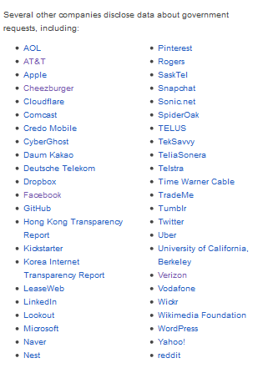
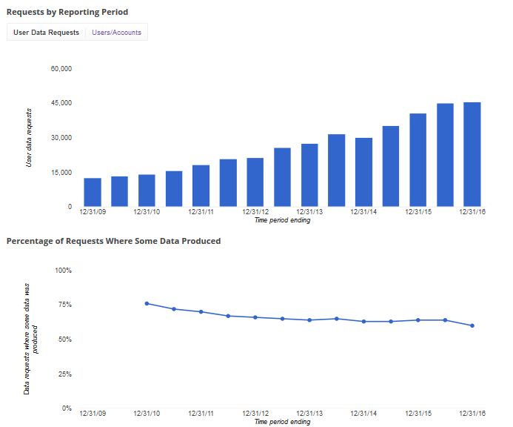
Post Snowden, companies have started releasing “Transparency Reports”
Sample from Google
Other Organizations that produce Transparency Reports

Slide 12
How Cathy O’Neil characterizes “Weapons of Math Destruction”
Algorithms that significantly impact peoples lives. She touches on systems such as:
loan rates
prison sentencing
teacher evaluations
II. Black box systems :
Does the user understand how (and even if) they are being rated
As machine learning gets more sophisticated, this problem will be exacerbated
III. Does it create a negative feedback loop?:
Is their a mechanism to test and change the system for biases and errors?
* If you don’t read Cathy O’Neil’s blog mathbabe, you’re making a mistake

Slide 13
Credit Scores vs. “E-scores (data brokers)”
Credit scores:
Governmental regulation
Provide clear advice on how to raise score
Legal (if inefficient) right to examine your score
Legal (if inefficient) right to challenge and correct underlying data
Models can see who actually defaults and then correct themselves
II. E-scores:
No regulation
No understand on consumer name of bucket they are placed into, much less underlying data collected
Many don’t allow right of removal
Unclear how they self-correct

Slide 14
What should I do?
Privacy issues are much more easily handled at the design phase:
Data Minimization: Only store data that is directly pertinent to your work
Data Retention: Do you have a process to remove unneeded data at regular intervals?
You can’t be forced to turn over data you don’t have, nor can you have a data breach with user info you have deleted
Data quality is so important! Think critically about the human biases inherent in the collection of the data you are using
For example, if policing has a quantifiable racial bias, should you use historical arrest data without any corrections?
Data is political and was in some way collected by a human
Garbage in Garbage out (just ask Nate Silver!)

Slide 15
The Hippocratic Oath for Data Scientists
I solemnly pledge to practice my profession with conscience and dignity;
To respect the privacy of the people whose data is confided in me;
To maintain the utmost respect for the individuals whose data I am analyzing;
To be transparent, open, and honest about the type of analysis I am applying to their data;
To never use my knowledge to violate human rights and civil liberties, even under threat
https://allthingsanalytics.com/2013/07/08/the-hippocratic-oath-for-the-data-scientist/

